Slide 1
SCUOLA PRIMARIA ‘ SAN PIO X ’ FOGGIA

Slide 2
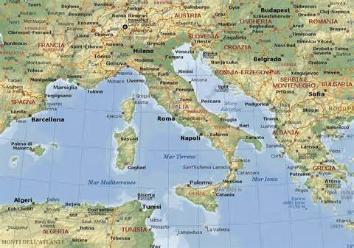
ITALY OUR WONDERFUL COUNTRY

Slide 3
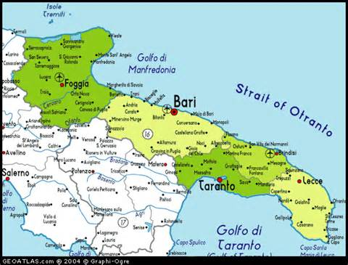
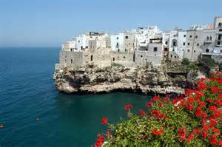
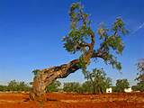
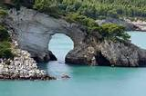
PUGLIA OUR REGION IN ITALY

Slide 4
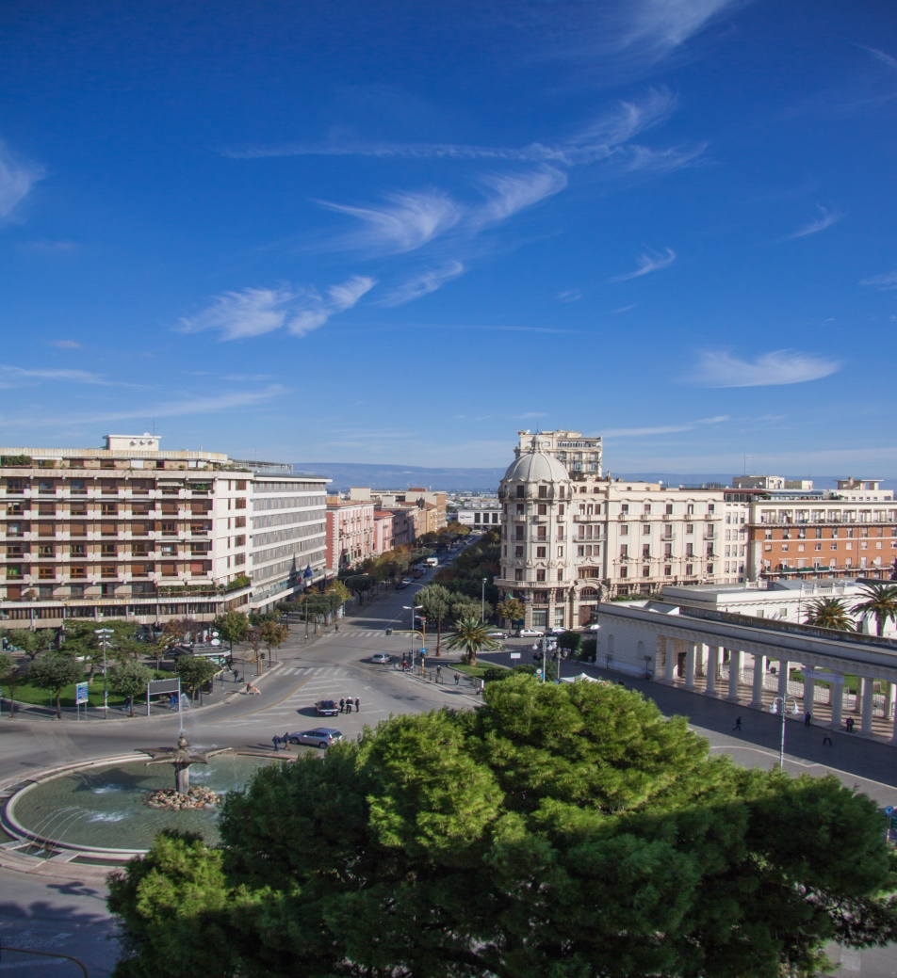
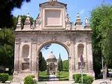
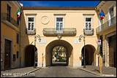
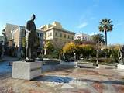
FOGGIA OUR TOWN

Slide 5
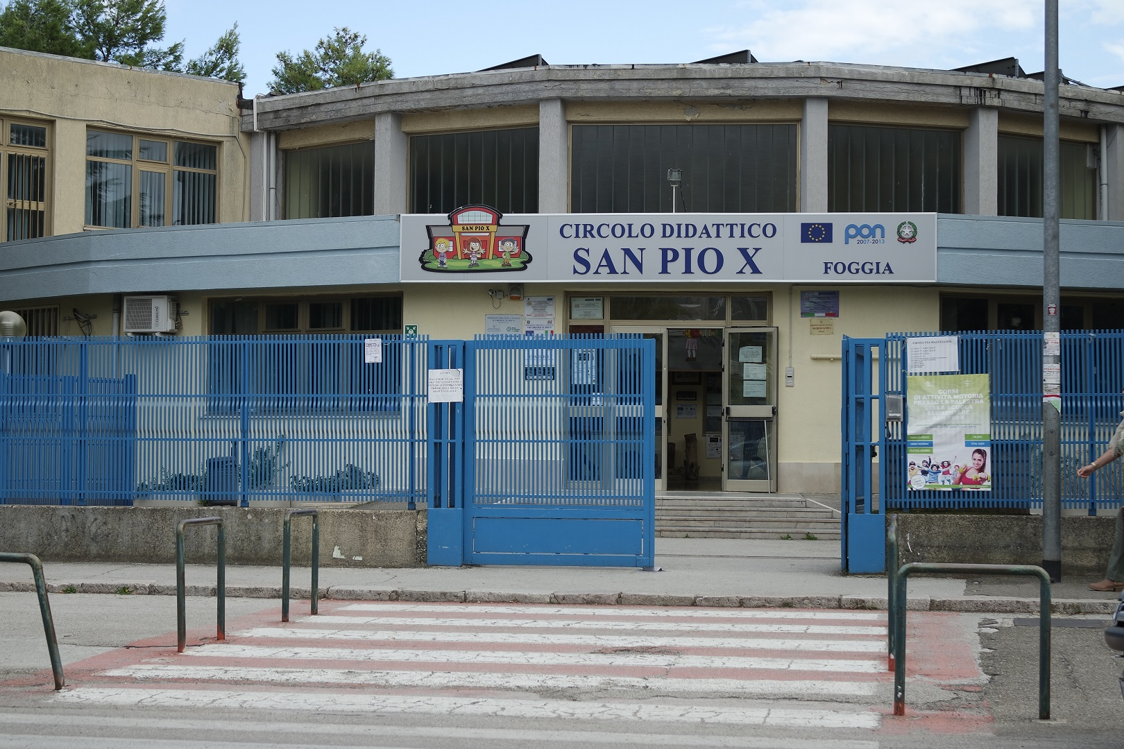
OUR SCHOOL ‘ SAN PIO X ’

Slide 6
STORKS IN SCIENCE ZONE
BRAIN EVOLUTION IN
AGES

Slide 7
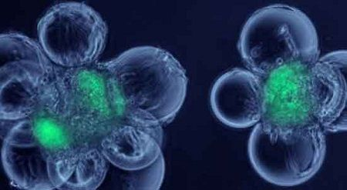
EARLY BRAINS
NERVE CELL BODIES
Early brains on our planet were very simple – and are found now in animals lower down the evolutionary ‘tree’, for example in insects, worms and snails. These early brains are more collections of ganglia – where hundreds of nerve cell bodies congregate.

Slide 8
WHAT HAPPENED ?
THE BRAIN STARTED TO BECOME ALWAYS MORE COMPLEX: MORE CELLS STARTED TO JOIN TOGETHER AS PRIMATES HAD TO FACE THEIR NEW ENVIRONMENT

Slide 9
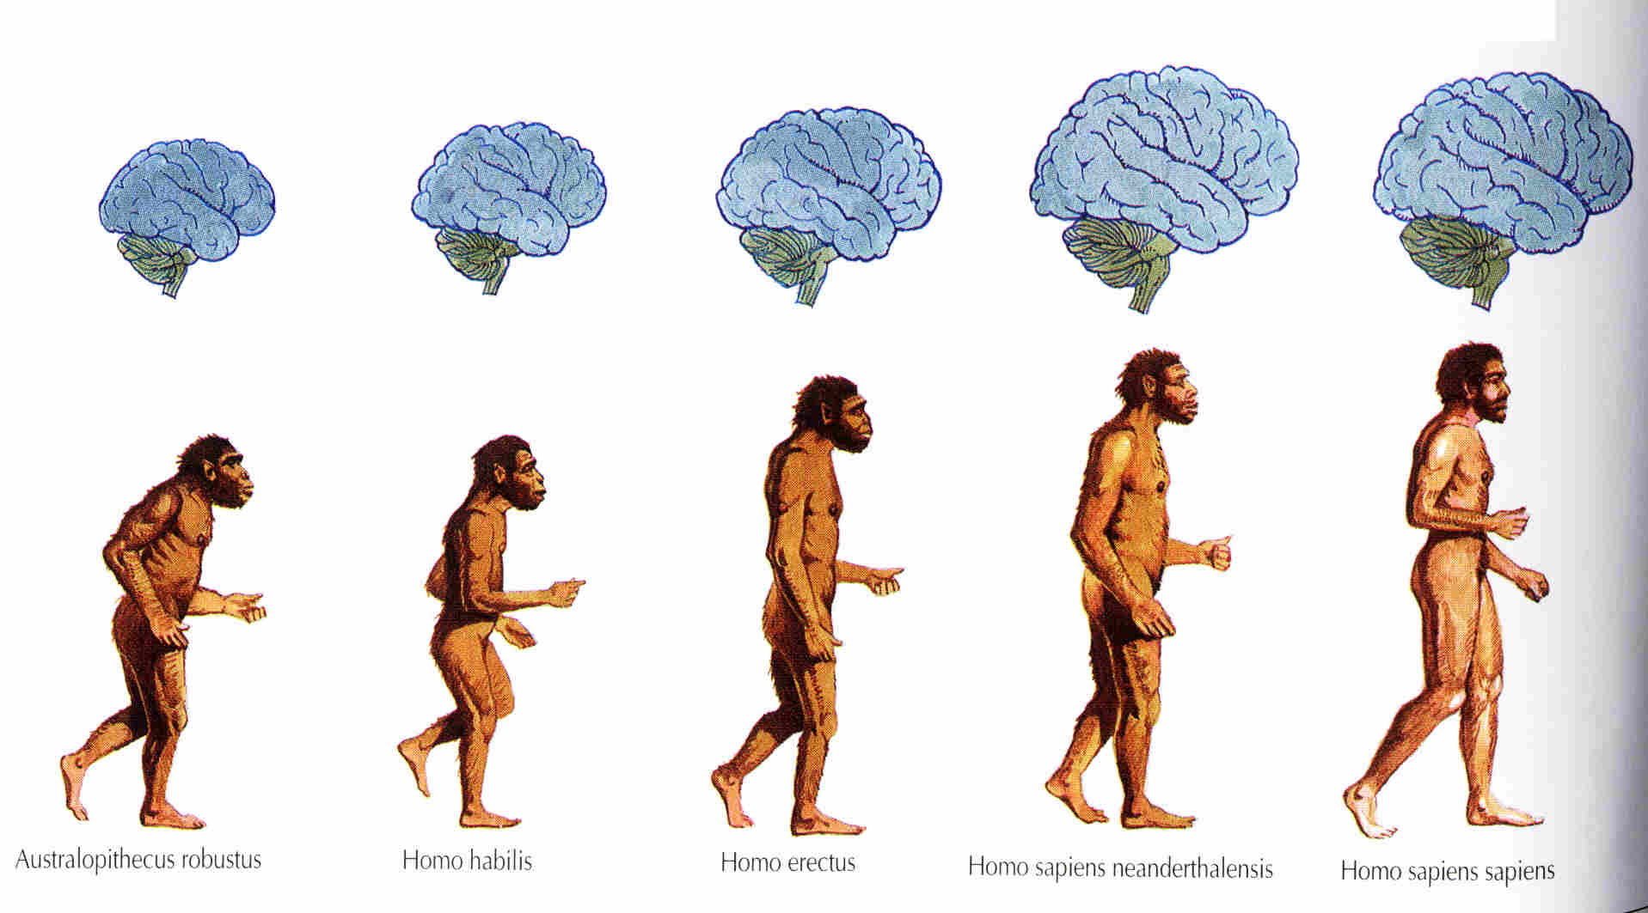
BRAIN DEVELOPS IN AGES

Slide 10
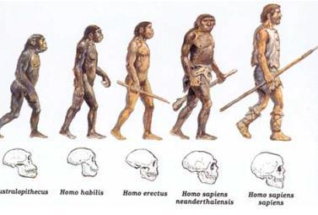
THE SKULL EVOLUTION

Slide 11
COMPLEX BRAINS FOR COMPLEX WORLD
HOMO ERECTUS
HOMO SAPIENS

Slide 12
EVOLUTION
As early humans faced new environmental challenges and evolved bigger bodies, they evolved larger and more complex brains.
Large, complex brains can process and store a lot of information. That was a big advantage to early humans in their social interactions and encounters with unfamiliar habitats.
Over the course of human evolution, brain size tripled. The modern human brain is the largest and most complex of any living primate.

Slide 13
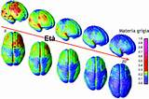
CHANGES
PHAENOMENA AND BRAINCASE VOLUME
between 800,000 and 200,000 years ago
Graphs showing changes in climate and changes in braincase volume.
To construct this graph, scientists measured the brain cavities of more than 160 early human skulls.
A large brain capable of processing new information was a big advantage during times of dramatic climate change

Slide 14
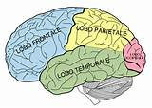
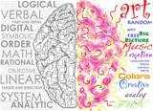
BENEFITS
The modern human brain can:
- store many decades of worthy information;
- collect and process information, then deliver output, in split seconds;
- solve problems and create abstract ideas and images.
It can also do much more.

Slide 15
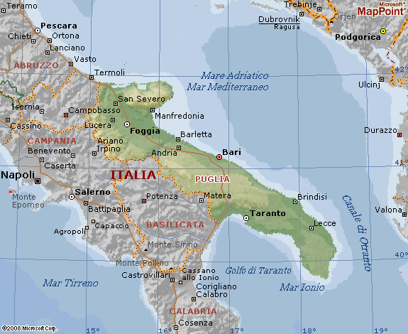
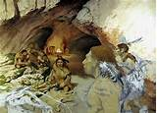
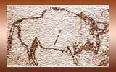
WHAT HAS BEEN DISCOVERED IN PUGLIA?
OUR REGION
CAVES AND GRAPHITS

Slide 16
THE PALEOLITHIC AGE
Humankind gradually evolved from early members of the genus Homo such as Homo habilis – who used simple stone tools – into fully behaviourally and anatomically modern humans (Homo sapiens) during the Paleolithic era

Slide 17
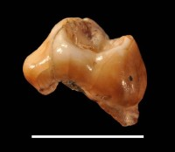
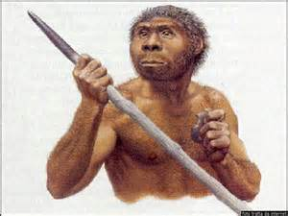
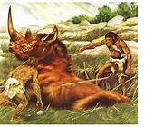
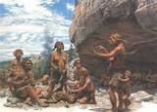
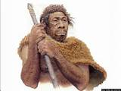
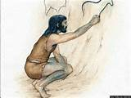
Grotta Paglicci
The most ancient testimonials of the modern man in Europe has been discovered in Puglia. “Grotta Paglicci ” was inhabited by the first sapiens in Europe about 45000 years ago.

Slide 18
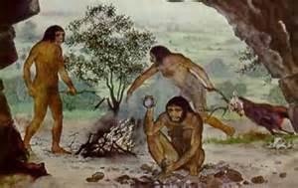
HUMAN WAY OF LIFE
All of our knowledge of Paleolithic human culture and way of life comes from archaeology.The economy of a typical Paleolithic society was a hunter-gatherer economy. Humans hunted wild animals for meat and gathered food, firewood, and materials for their tools and clothes.

Slide 19
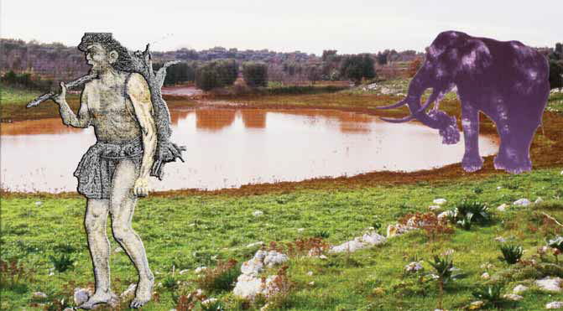

Slide 20
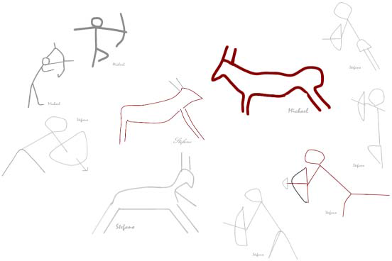
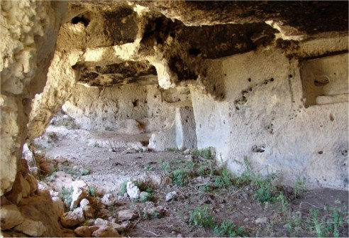
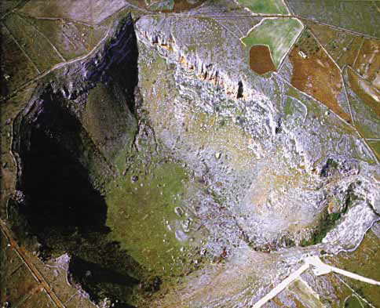
PAINTINGS
Humans began to produce works of art such as cave paintings, rock art and jewellery and began to engage in religious behavior such as burial and ritual.

Slide 21
THANKS
This power point has been realized by the teachers and the students of the 5th year classes of our primary school .
It has been introduced by
CASSANELLI GIANMAURO
GRAMAZIO SOPHIA
PASQUINI FEDERICA
PETROZZI PAOLO
TOMAIUOLO MICHELE
during the Spanish meeting in November 2016

